Slide 1

HACK-AI-THON 2026 / GROUP 5
GreenGrid
Smart Energy &
Carbon Tracker

Slide 2
01 / OVERVIEW
One file. Four useful answers.
A single-file Python Tkinter application that turns appliance usage into energy, cost, carbon and efficiency insights — helping households act, not guess.
MONITOR → UNDERSTAND → REDUCE
greengrid.py
GREENGRID • HACK-AI-THON 2026 • GROUP 5

Slide 3
02 / CAPABILITIES
Everything needed to close the loop
TRACK
CALCULATE
RANK
Per-appliance usage, category and hours
₹7.50/kWh tariff + 0.82 kg CO₂/kWh
Efficiency score and top consumers
ADVISE
PERSIST
NAVIGATE
Explainable appliance-specific actions
Local JSON continuity + CSV export
Dashboard, Appliances, Reports, Settings
GREENGRID • HACK-AI-THON 2026 • GROUP 5

Slide 4
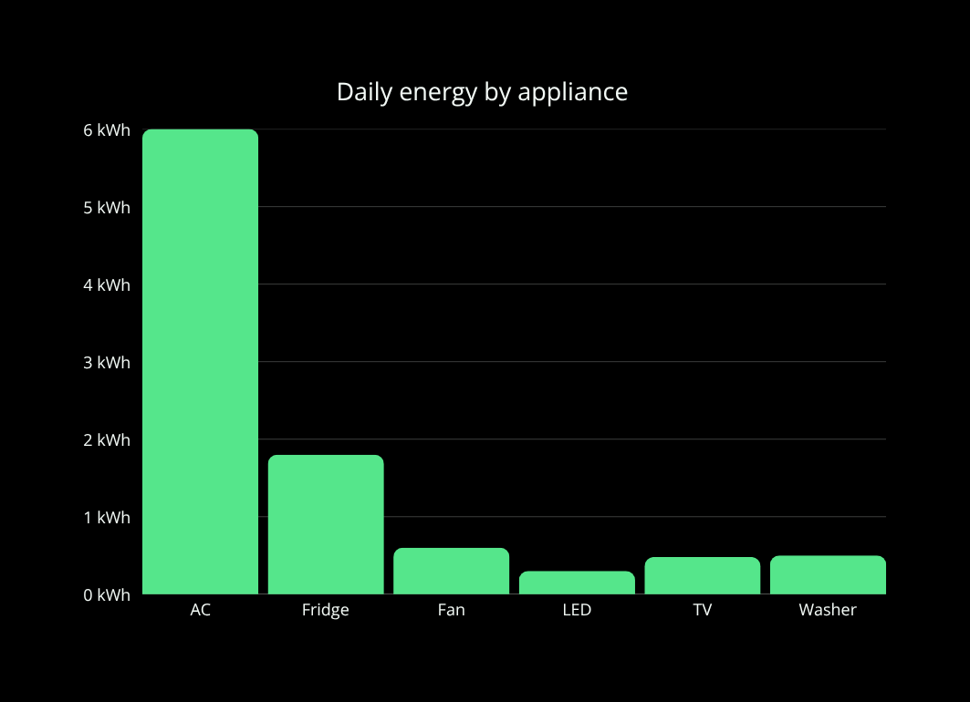
03 / SAMPLE DATA
Watts become decisions
POWER (W) × HOURS ÷ 1000 = kWh
AIR CONDITIONER 1500W × 4h 6.00 kWh
REFRIGERATOR 180W × 10h 1.80 kWh
CEILING FAN 75W × 8h 0.60 kWh
LED LIGHTS 60W × 5h 0.30 kWh
TELEVISION 120W × 4h 0.48 kWh
WASHING MACHINE 500W × 1h 0.50 kWh
A daily view makes invisible consumption visible.
GREENGRID • HACK-AI-THON 2026 • GROUP 5

Slide 5
04 / IMPLEMENTATION
Clean model. Strong validation.
APPLIANCE
identity + watts + category
ENERGY RECORD
hours + period + date + kWh
ENERGY REPORT
aggregate + cost + CO₂ + score
VALIDATE
COMPUTE
EXTEND
Positive power • valid hours • clean dates
energy_kwh is derived — never duplicated
Separation keeps the code testable and maintainable
GREENGRID • HACK-AI-THON 2026 • GROUP 5

Slide 6
05 / SMART LOGIC
Personalized advice, explained
AIR CONDITIONER
Set 24–26°C; clean filters regularly.
REFRIGERATOR
Minimize door-open time; check seals.
LIGHTING
Switch to LEDs; use daylight first.
WASHING
Run full loads on eco cycles.
HEAVY USE
Flag >8 hours or >5 kWh for action.
RULE-BASED • TRANSPARENT • NO GENERATIVE AI AT RUNTIME
GREENGRID • HACK-AI-THON 2026 • GROUP 5

Slide 7
06 / EXPERIENCE
A dashboard built for action
DASHBOARD
APPLIANCES
REPORTS
SETTINGS
SDG 7 • SDG 11 • SDG 13
ADD • REPORT • EXPORT CSV • SAMPLE DATA
GREENGRID • HACK-AI-THON 2026 • GROUP 5

Slide 8
07 / DATA
Local-first, portable by design
GREENGRID
VALIDATE + CALCULATE
greengrid_data.json
LOAD + SAVE
REPORT.csv
DETAIL + SUMMARY
Error-handled loading
Sample data option
Easy sharing & reporting
Continuity without accounts, servers or lock-in.
GREENGRID • HACK-AI-THON 2026 • GROUP 5

Slide 9
08 / TRANSPARENCY
AI-assisted development. Not AI-dependent.
AI SUPPORT
APPLICATION RUNTIME
Ideation & concept framing
Code review & debugging suggestions
UX and content refinement
Presentation & documentation support
Python standard library only
Tkinter interface
JSON + CSV persistence
Rule-based recommendations
NO EMBEDDED MODEL
NO EXTERNAL AI API
GREENGRID • HACK-AI-THON 2026 • GROUP 5

Slide 10
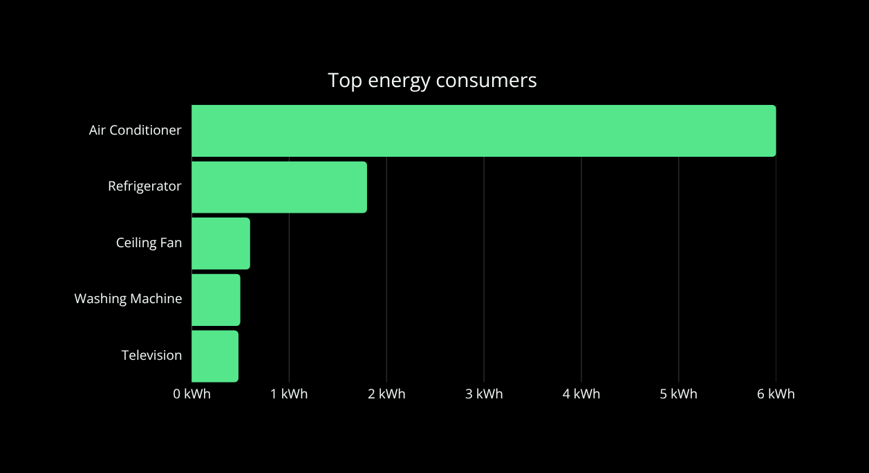
09 / IMPACT
A daily footprint, made actionable
9.68
₹72.60
7.94 kg
78/100
kWh ENERGY
EST. COST
CO₂ EMISSIONS
GREEN SCORE
NEXT BEST ACTION
Raise AC setpoint to 24–26°C.
GreenGrid turns measurement into a practical sustainable choice.
GREENGRID • HACK-AI-THON 2026 • GROUP 5

Slide 11
GROUP 5 / HACK-AI-THON 2026
Built together.
Designed for impact.
MOHAMED AATHIF PARAS SHAH
VETRI SELVAN SANKET HORE
THANK YOU

